Slide 1
MS Project Présentation

Slide 3
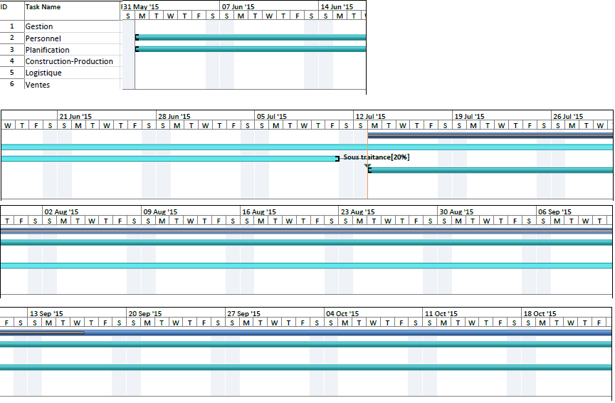

Slide 4
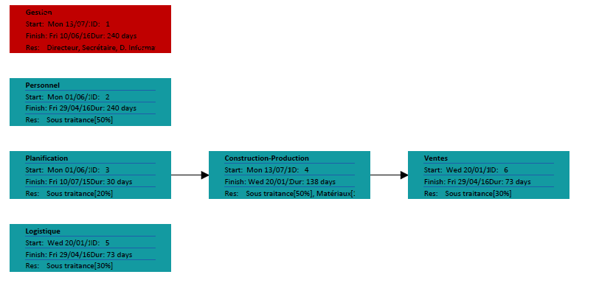

Slide 6
Tasks | All
 |  | Data
Year | Quarter | Cost | Cumulative Cost
2015 | Q2 | 4920 | 4920
 | Q3 | 78227.50007 | 83147.50007
 | Q4 | 98706.66672 | 181854.1668
2015 Total |  | 181854.1668 | 181854.1668
2016 | Q1 | 94516.58333 | 276370.7501
 | Q2 | 62061.24998 | 338432.0001
2016 Total |  | 156577.8333 | 338432.0001
Grand Total |  | 338432.0001 | 338432.0001

Slide 7
